Slide 1
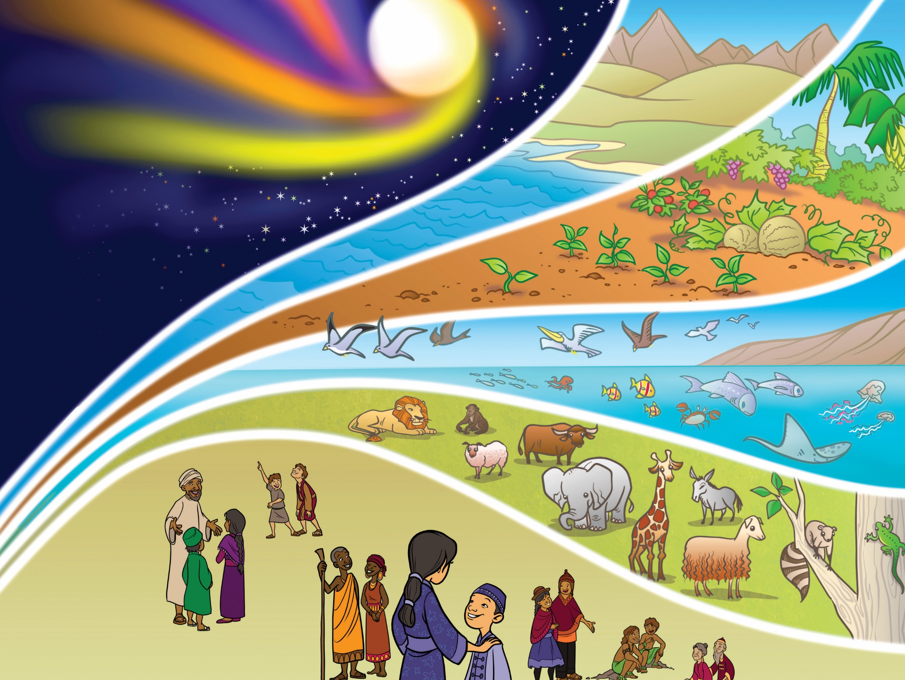
Notes:
In the beginning God created the heavens and the earth. What do you see in the picture that God created? (Take
responses.) God created people like you and me to know, love and obey him. He created everything and he made
everything good. Humans were in a perfect relationship with God. Everything was good, but something happened.
(1 Minute)

Slide 2
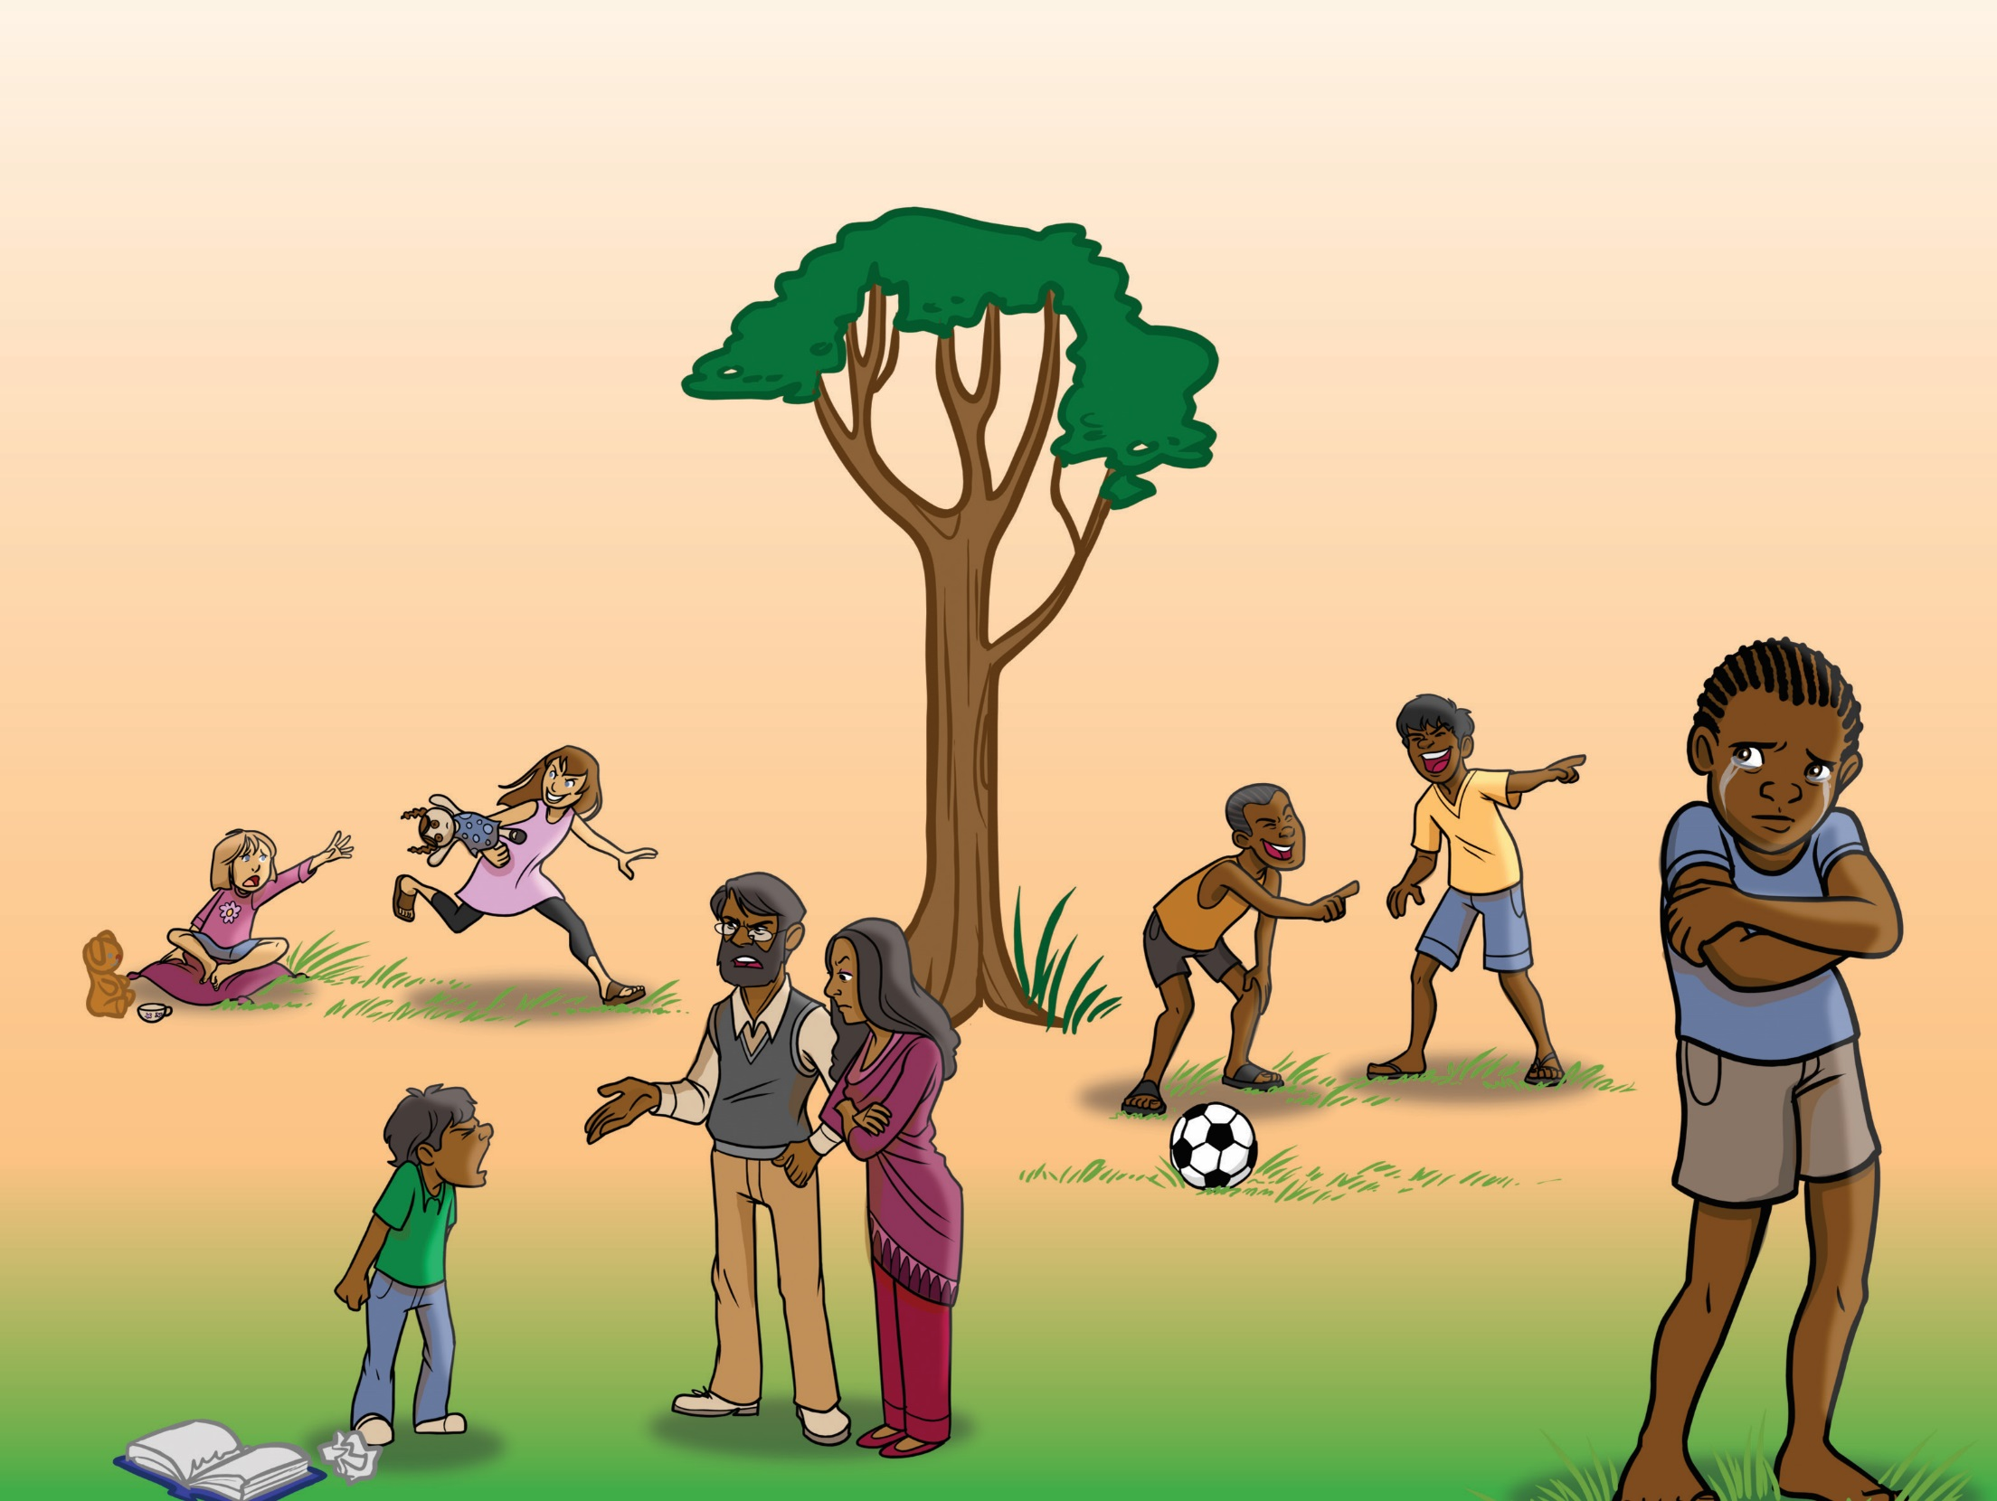
Notes:
Adam and Eve were the first people God created. They disobeyed God. Each one of us also disobeys God. God called
our disobedience sin. Definition: Sin is anything we do, say or think that goes against God. (Lead the children in these
hand motions as you define sin: do [hit fist on open hand], say [point to your mouth], think [point to your head].) What
things in this picture are not right? (Allow the children to comment on the pictures.) The consequences of our sin are
shame and separation from God. He is so perfect and good that He cannot ignore our sin. Sin must be punished. The
punishment for sin is death. The Bible says in Romans 3:23, “For all have sinned and fall short of the glory of God.” We
need God to rescue us!
(2 Minutes)

Slide 3
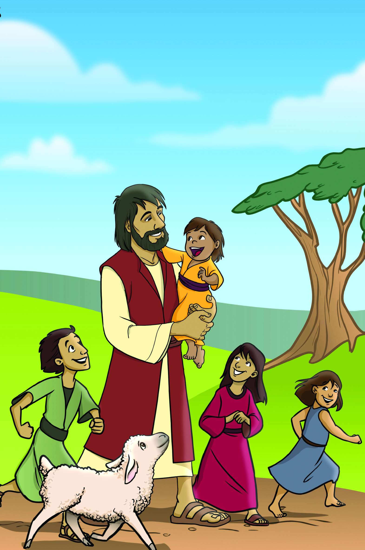
Notes:
God loves us and sent Jesus because we need to be rescued from our sin and shame. The Bible says in John 3:16, “For
God so loved the world, that He gave His only son, that whoever believes in Him should not perish but have eternal
life.” Jesus loves you and willingly came from God to rescue you from the penalty and shame of your sin. Jesus never
sinned. He always obeyed and honored God. (Repeat hand motions.) Jesus never did, said, or thought anything against
God.
(1 minute)

Slide 4
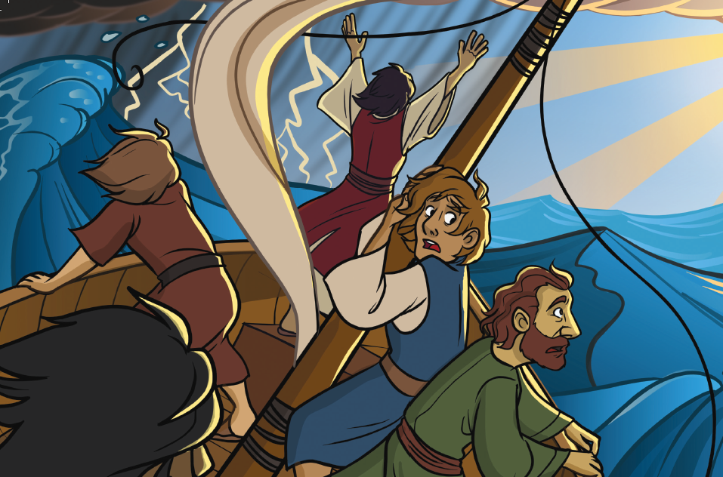
Notes:
We learn about Jesus in the Bible. Jesus did many amazing things. (Point to the pictures.) Jesus had power to calm
a storm and make a dead person come to life. He healed people and cared for their needs. Jesus showed again and
again He is God’s Son. He did many things that proved He was God, but not everyone believed. Even though He did
many good things, there were people who hated Jesus.

Slide 6
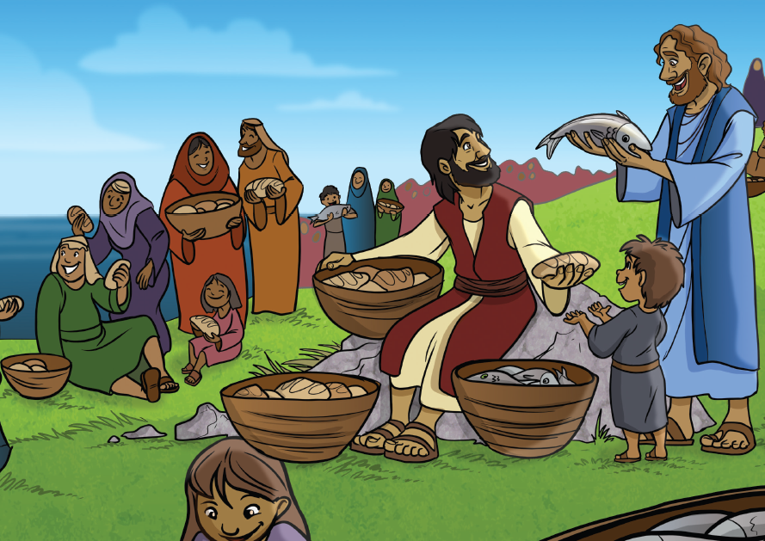

Slide 7
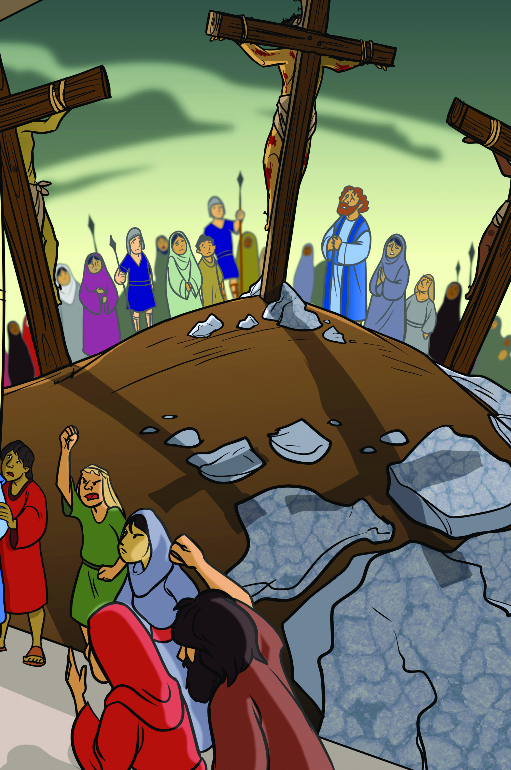
Notes:
The people who hated Jesus falsely accused Him, even though He had never done anything wrong. The people nailed
Him to a cross. Jesus willingly died on the cross to take our shame and punishment. After Jesus died, they put Him in
a tomb and covered it with a stone.
(1 minute)

Slide 8
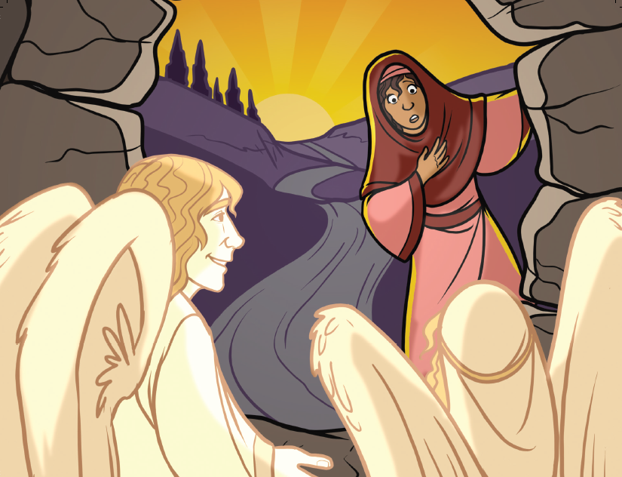
Notes:
But that’s not the end. Three days after He died, He came back to life. Jesus rose from the grave. Angels at the
empty tomb said, “He is not here, He is alive!” His relationship with God could not be broken. We can have that same
relationship. Jesus overcame death so that we could have a new life. (Point to the empty tomb.) Jesus appeared to His
disciples and commanded them to go and tell everyone that He is alive. He is alive today.
(1 minute)

Slide 9
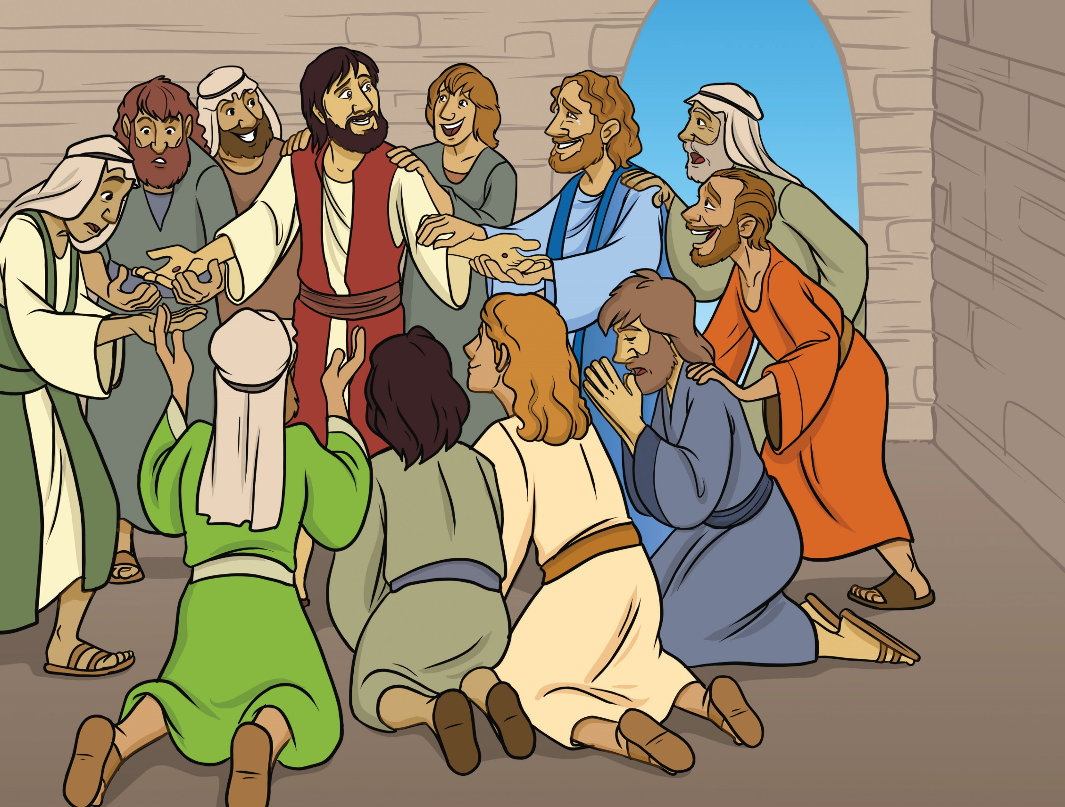
Notes:
Jesus rose from the grave. He is alive. Jesus overcame death so that we could have a new life.
Action:
Point to Jesus. Emphasize that he appeared to his disciples. Emphasize that he is alive today.
(30 seconds)

Slide 10
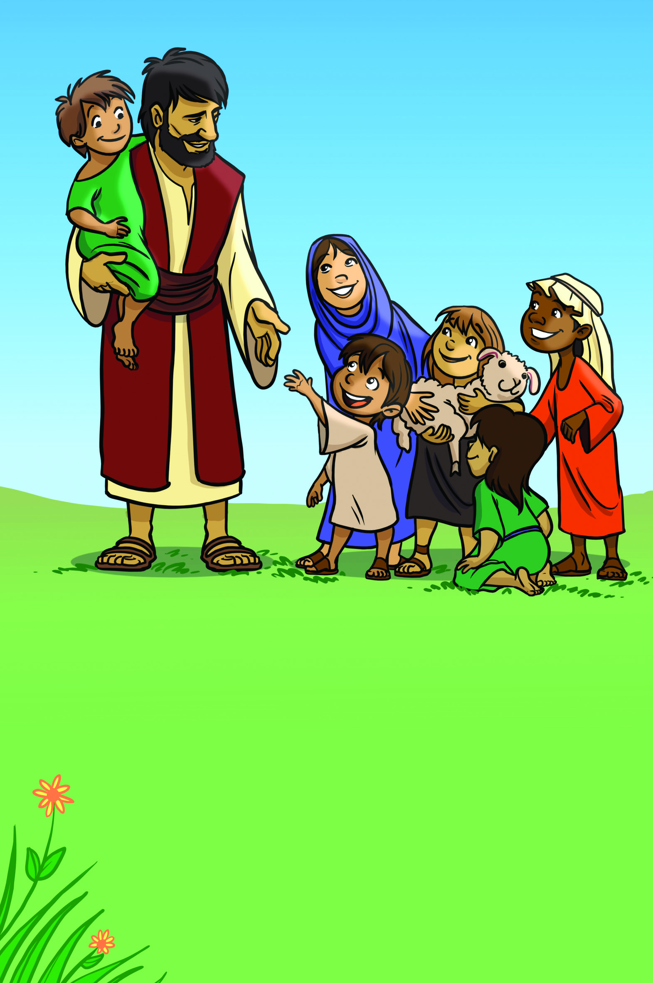
Notes:
Jesus invites you to be His friend and follower. He can save you from the bad things that you do. You can have a
relationship with God and one day go to heaven to be with Him. Romans 10:9 says that “If you openly declare that
Jesus is Lord and believe in your heart that God raised him from the dead, you will be saved.” If you want to put your
faith in Jesus, then pray this prayer with me. (Pray together.) (Point to the picture.) As you follow Jesus, you will talk to
God and read the Bible. Following Jesus changes what you do, say, and think. You can now tell your friends how they
can put their trust in Jesus.

Slide 11
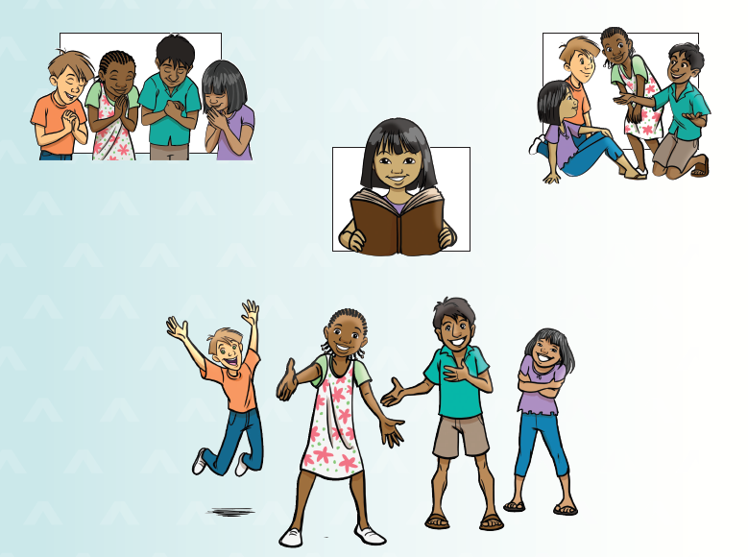
Notes:
Dear God,
I want to be Your friend and
follower.
I know that I have disobeyed
You. I am sorry. Please
forgive me.
I believe that Jesus died to
take the punishment for my
sins. I believe that Jesus is
alive today.
Give me faith to trust and
follow only You. I am Yours.
Amen.
(Point to the picture.)
As you follow Jesus, you
will talk to God and read
the Bible. Following Jesus
changes what you do, say,
and think.
You can now tell your friends
how to put their trust in
Jesus.

